Slide 1
Profesjonalne aplikacje dla biznesu klasy Enterprise
Wprowadzenie do Jakarta EE (Java EE 8)
Piotr Apollo
Krzysztof Grel

Slide 2
What is the Java EE 8 platform?
The Java EE platform provides an API and runtime environment for developing and running large-scale, multi-tiered, scalable, reliable, and secure network (enterprise) applications.

Slide 3
Java EE 8 platform
Specification – defines a set of APIs and their interaction
Runtime
Application server
Full Profile
Web Profile
GlassFish 5 – a reference implementation
Extends Java SE APIs

Slide 4
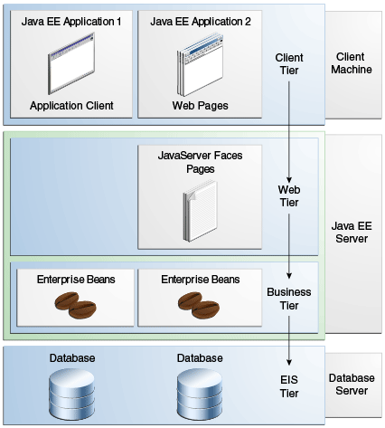
Distributed Multi-tiered Applications

Slide 5
The key goals of the Java EE 8 platform
To modernize the infrastructure for enterprise Java for the cloud and microservices environments,
emphasize HTML5 and HTTP/2 support,
enhance ease of development through new Contexts and Dependency Injection features,
and further enhance security and reliability.

Slide 6
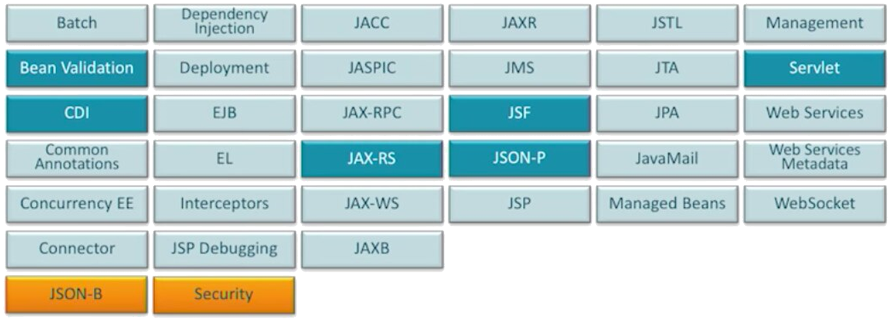
Java EE 8 – APIs Overview

Slide 7
Java EE 8
New
Java API for JSON Binding (JSON-B)
Java EE Security API
Updated
Java Servlet (3.1 -> 4.0)
Contexts and Dependency Injection (CDI, 1.1. -> 2.0)
JavaBean Validation (1.1 -> 2.0)
JSON Processing (JSON-P, 1.0 -> 1.1)
RESTful web services (JAX-RS, 2.0 -> 2.1)

Slide 8
Java Servlet 4.0 (Servlet)
A servlet is a Java programming language class used to extend the capabilities of servers that host applications accessed by means of a request-response programming model.
Although servlets can respond to any type of request, they are commonly used to extend the applications hosted by web servers.

Slide 9
Servlet - Lifecycle
import java.io.IOException;
import javax.servlet.ServletException;
import javax.servlet.annotation.WebServlet;
import javax.servlet.http.HttpServlet;
import javax.servlet.http.HttpServletRequest;
import javax.servlet.http.HttpServletResponse;
@WebServlet(„first-servlet")
public class FirstServlet extends HttpServlet
{
@Override
protected void doGet(
HttpServletRequest req, HttpServletResponse resp)
throws ServletException, IOException
{
// implement logic
}
}
The lifecycle of a servlet is controlled by the container in which the servlet has been deployed.
When a request is mapped to a servlet, the container performs the following steps.
If an instance of the servlet does not exist, the web container:
Loads the servlet class
Creates an instance of the servlet class
Initializes the servlet instance by calling the init method
The container invokes the service method, passing request and response objects.
If it needs to remove the servlet, the container finalizes the servlet by calling the servlet’s destroy method.

Slide 10
Servlet – Lifecycle Events
import javax.servlet.annotation.WebListener;
import javax.servlet.http.HttpSessionEvent;
import javax.servlet.http.HttpSessionListener;
@WebListener
public class SessionListener implements HttpSessionListener
{
public void sessionCreated(HttpSessionEvent se)
{
// implement logic
}
public void sessionDestroyed(HttpSessionEvent se)
{
// implement logic
}
}
Monitoring and reacting to events in a servlet’s lifecycle by defining listener objects whose methods get invoked when lifecycle events occur. Use the @WebListener annotation to define a listener to get events for various operations on the particular web application context.
Classes annotated with @WebListener must implement one of the following interfaces:
javax.servlet.ServletContextListener
javax.servlet.ServletContextAttributeListener
javax.servlet.http.HttpSessionListener
javax.servlet.http.HttpSessionActivationListener
javax.servlet.http.HttpSessionAttributeListener
javax.servlet.ServletRequestListener
javax.servlet.ServletRequestAttributeListener

Slide 11
Servlet – Scope Objects
Collaborating web components share information by means of objects that are maintained as attributes of four scope objects:
Web context (javax.servlet.ServletContext)
Session (javax.servlet.http.HttpSession)
Request (Subtype of javax.servlet.ServletRequest)
Page (JSP) (javax.servlet.jsp.JspContext)
In a multithreaded server, shared resources can be accessed concurrently.

Slide 12
Servlet - Filtering Requests and Responses
import javax.servlet.Filter;
import javax.servlet.FilterChain;
import javax.servlet.ServletException;
import javax.servlet.ServletRequest;
import javax.servlet.ServletResponse;
import javax.servlet.annotation.WebFilter;
import javax.servlet.annotation.WebInitParam;
@WebFilter(filterName = "FirstFilterExample",
urlPatterns = {"first-servlet"},
initParams = { @WebInitParam(name = "mode", value = "test")})
public class FirstFilter implements Filter
{
public void doFilter(ServletRequest request, ServletResponse response, FilterChain chain)
throws IOException, ServletException
{
// implement you logic
chain.doFilter(request, response);
}
}
Can transform the header and content (or both) of a request or response
Provides functionality that can be "attached" to any kind of web resource
The order of the filters in the chain is the same as the order in which filter mappings appear in the web application deployment descriptor (web.xml ).
doFilter() do the job

Slide 13
Context and Dependency Injection (CDI)
A major theme of CDI is loose coupling. CDI does the following:
Decouples the server and the client by means of well-defined types and qualifiers, so that the server implementation may vary
Decouples the lifecycles of collaborating components by
Making components contextual, with automatic lifecycle management
Allowing stateful components to interact like services, purely by message passing
Completely decouples message producers from consumers, by means of events
Decouples orthogonal concerns by means of Java EE interceptors

Slide 14
CDI – Provided Services
Contexts
Dependency injection
The ability to decorate injected components
Typesafe interceptor bindings
An event-notification model
Additional web conversation scope
Integration with the Expression Language (EL)
A complete Service Provider Interface (SPI) that allows third-party frameworks to integrate cleanly in the Java EE environment

Slide 15
CDI – Managed Bean
A (nonempty) set of bean types
A (nonempty) set of qualifiers
A scope
Optionally, a bean EL name
A set of interceptor bindings
A bean implementation

Slide 16
CDI - Injection
The following kinds of objects can be injected:
Almost any Java class
Session beans
Java EE resources
data sources, Java Message Service topics, queues, connection factories, and the like
Persistence contexts (Java Persistence API EntityManager objects)
Producer fields
Objects returned by producer methods
Web service references
Remote enterprise bean references

Slide 17
CDI – Predefined Beans
Interface | Example
javax.transaction.UserTransaction | @Resource UserTransaction transaction;
java.security.Principal | @Resource Principal principal;
javax.validation.Validator | @Resource Validator validator;
javax.validation.ValidatorFactory | @Resource ValidatorFactory factory;
javax.servlet.http.HttpServletRequest | @Inject HttpServletRequest req;
javax.servlet.http.HttpSession | @Inject HttpSession session;
javax.servlet.ServletContext | @Inject ServletContext context;

Slide 18
CDI - Qualifiers
Allows providing various implementation of bean type
Java annotation
@Qualifier
@Retention(RUNTIME)
@Target({TYPE, METHOD, FIELD, PARAMETER})
public @interface Electric {}
public class DieselCar extends Car {
public int emmission()
{ return 98; }
}
public class ElectricCarFootprint extends CartFootprint {
@Electric @Inject private Car car;
// some business logic
}
@Electric
public class ElectricCar extends Car {
public int emmission()
{ return 0; }
}

Slide 19
CDI – Producer Method
Producer methods provide a way to inject objects that are not beans, objects whose values may vary at runtime, and objects that require custom initialization.
Qualifier
@MaxSpeed
Producer Method
private int maxSpeed = 250;
...
@Produces @MaxSpeed
int getMaxSpeed() {
return maxSpeed;
}
Injection Point
@Inject @MaxSpeed
private int maxSpeed;

Slide 20
CDI - Interceptor
An interceptor is a class used to interpose in method invocations or lifecycle events - cross-cutting tasks - that occur in an associated target class.

Slide 21
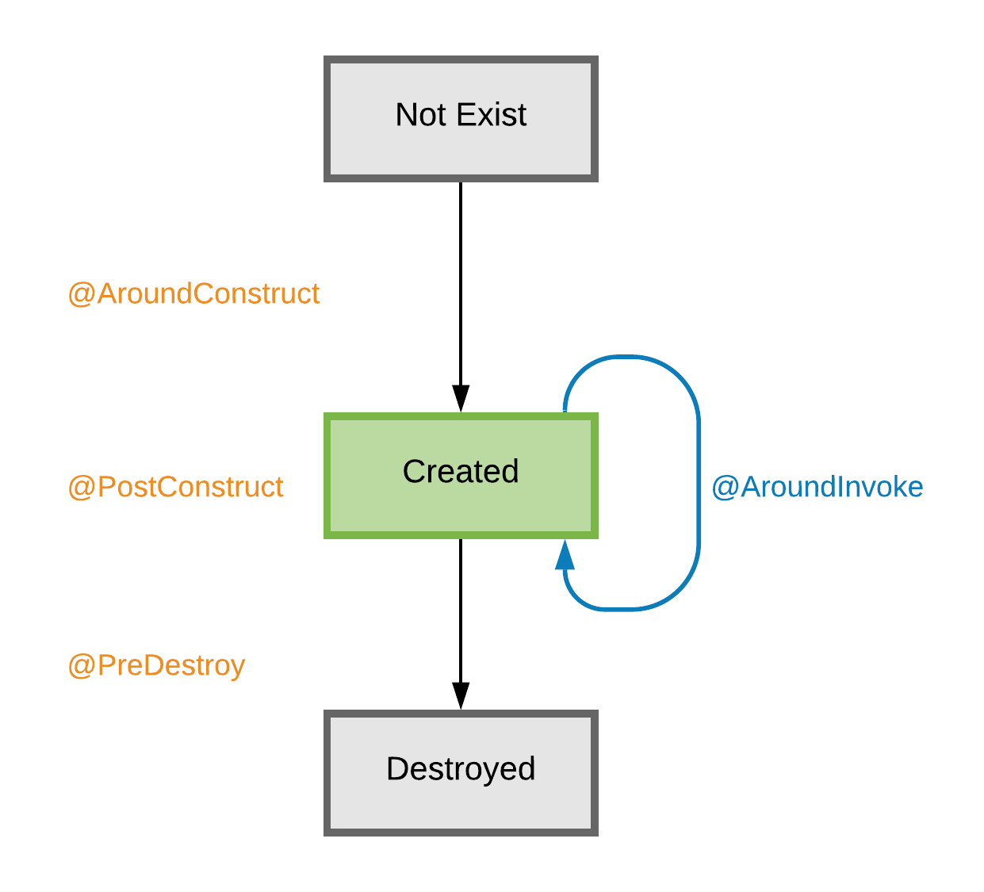
CDI – Interceptor lifecycle callback methods

Slide 22
CDI - Scope
@RequestScoped
A user’s interaction with a web application in a single HTTP request.
@SessionScoped
A user’s interaction with a web application across multiple HTTP requests.
@ApplicationScoped
Shared state across all users' interactions with a web application.
@Dependent
The default scope if none is specified; it means that an object exists to serve exactly one client (bean) and has the same lifecycle as that client (bean).
@ConversationScoped
A user’s interaction with a servlet, including JavaServer Faces applications. The conversation scope exists within developer-controlled boundaries that extend it across multiple requests for long-running conversations. All long-running conversations are scoped to a particular HTTP servlet session and may not cross session boundaries.
Notes:
Scope
Annotation
Duration
Request
@RequestScoped
A user’s interaction with a web application in a single HTTP request.
Session
@SessionScoped
A user’s interaction with a web application across multiple HTTP requests.
Application
@ApplicationScoped
Shared state across all users' interactions with a web application.
Dependent
@Dependent
The default scope if none is specified; it means that an object exists to serve exactly one client (bean) and has the same lifecycle as that client (bean).
Conversation
@ConversationScoped
A user’s interaction with a servlet, including JavaServer Faces applications. The conversation scope exists within developer-controlled boundaries that extend it across multiple requests for long-running conversations. All long-running conversations are scoped to a particular HTTP servlet session and may not cross session boundaries.

Slide 23
Enterprise Bean 3.2 (EJB)
Written in the Java programming language, an enterprise bean is a server-side component that encapsulates the business logic of an application. The business logic is the code that fulfills the purpose of the application.
The EJB container provides system-level services to enterprise beans.

Slide 24
EJB
Run in the EJB container
provides system-level services, such as transaction management and security authorization.
Supports Client-Server architecture
Separates business logic from presentation logic
Component scaling
Transparent component distribution

Slide 25
EJB - Types
Session Bean
@Stateless
@Local
@Remote
@Stateful
@Local
@Remote
@Singleton
Lazy loading strategy
Eagle loading strategy by using @Startup
Message-Driven Bean
messages are processed asynchronously
normally acts as a JMS message listener
can process messages from different clients

Slide 26
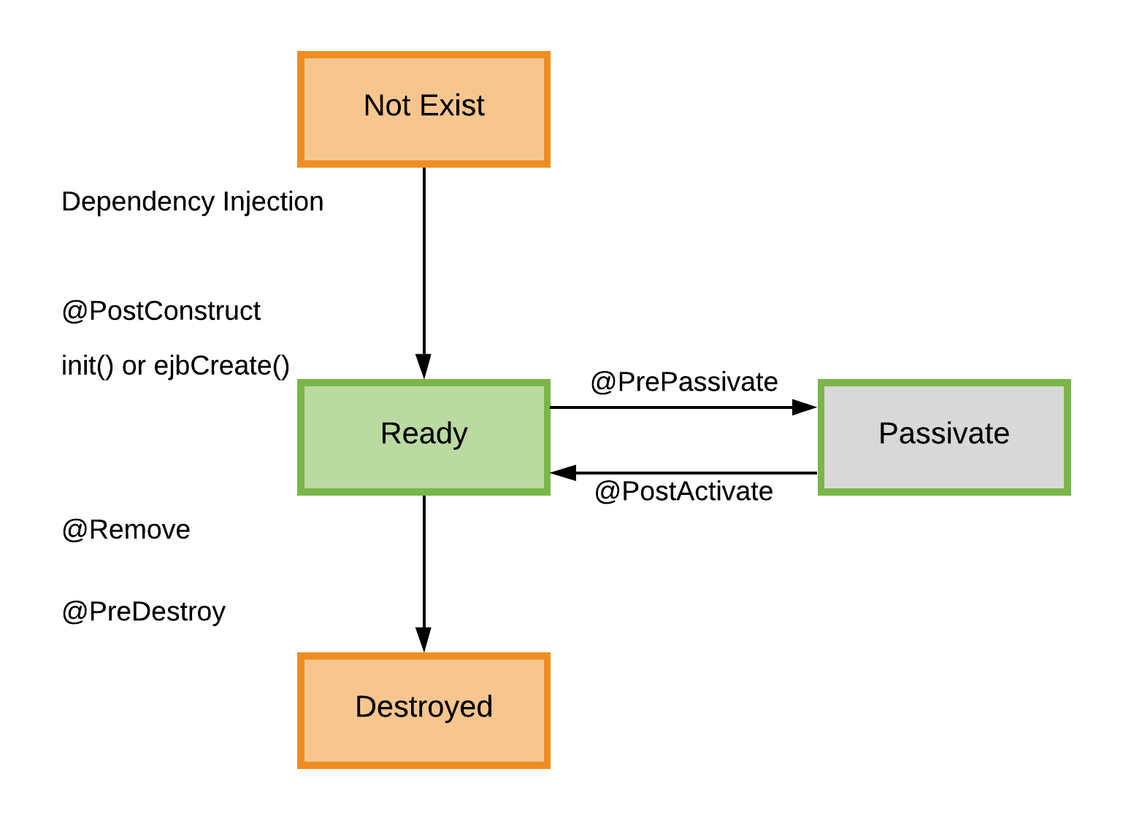
EJB – Stateful Session Bean

Slide 27
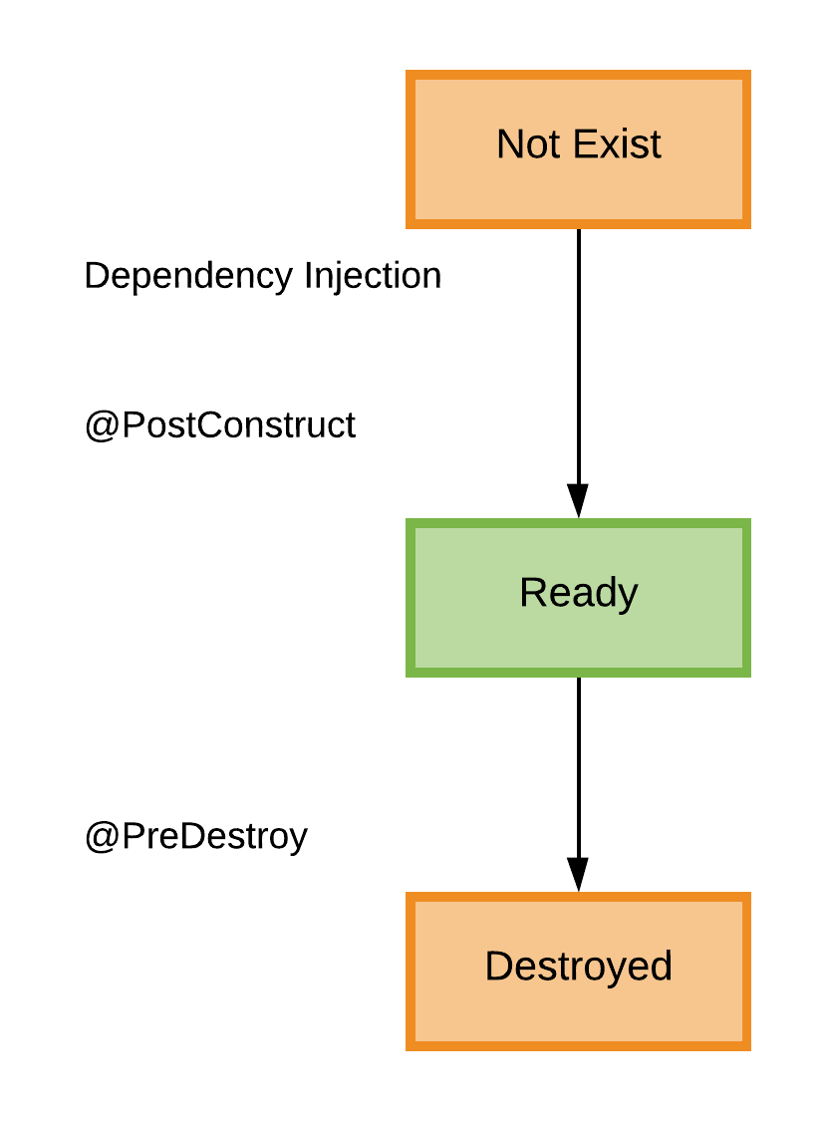
EJB – Stateless Session Bean

Slide 28
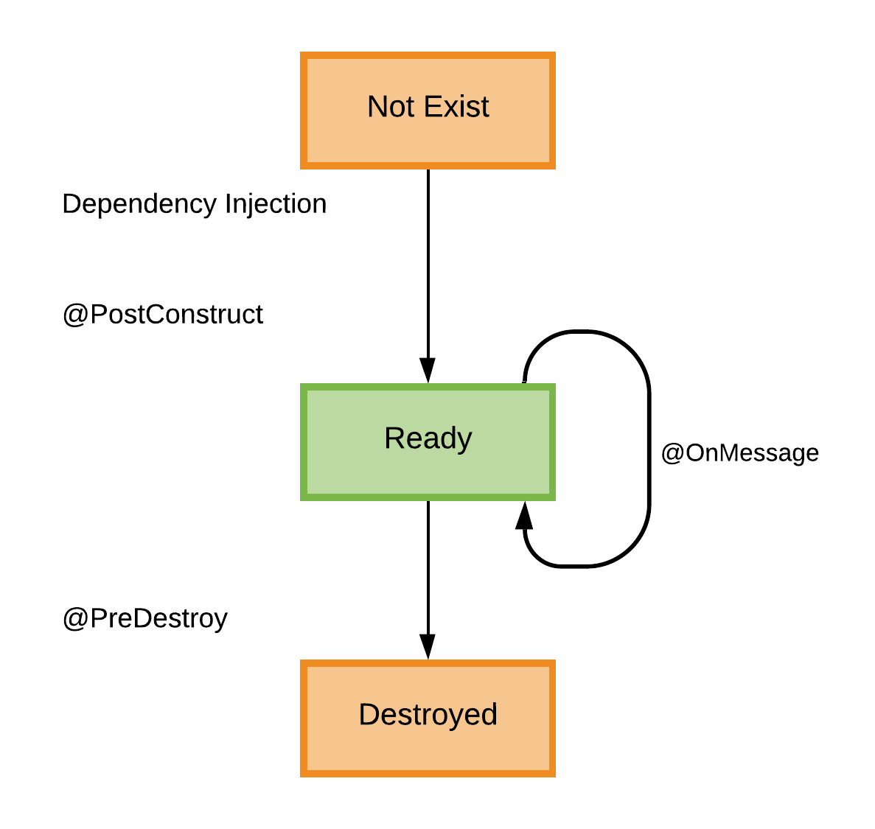
EJB – Message-Driven Bean

Slide 29
Summary
Servlet
Well defined lifecycle
Scopes
Filter
CDI
loose coupling
Provides services – eg. Contexts, dependency injection
Well defined lifecycle – Interceptor
Enhnace servlet scopes
EJB
Session Bean
Statfull
Stateless
Sngleton
Message-Driven Bean

Slide 30


Thank You.
Any questions?
Piotr Apollo
Krzysztof Grel

Slide 31
Additional information
https://www.oracle.com/technetwork/java/javaee/tech/index.html
https://javaee.github.io/tutorial/
https://javaee.github.io/tutorial/toc.html
https://en.wikipedia.org/wiki/Java_Platform,_Enterprise_Edition

